Slide 1
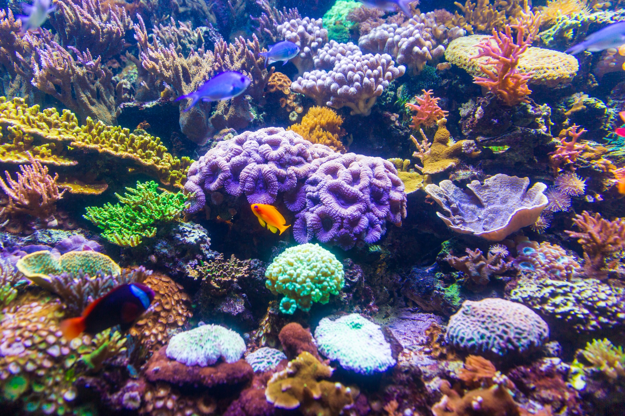
Blind Image Quality Assessment

Slide 2
What is image quality assessment ?
Image quality assessment models are very important to characterize the visual quality of an image.
The goal of the IQA research is to develop objective metrics for measuring image quality and the results should be consistent with the subjective judgments
Image Quality Assessment (IQA) may be specified into two categories, namely subjective and objective evaluations.
Subjective evaluation occurs when the images are evaluated by human, who provide scores based on their perception on the image quality.
While objective evaluation involves mathematical algorithms to calculate the quality score for the images

Slide 3
The objective evaluation
The objective evaluation consists of three categories, namely
Full-Reference-IQA (FR-IQA) : that use the original version of the image for estimating the quality of the processed version. These models are the most used methods to evaluate image quality (for example, the well-known PSNR and SSIM).
Reduced Reference-IQA (RR-IQA) : that analyze the processed image using some relevant information to calculate the quality of the result image.
No-Reference/Blind-IQA (NR-IQA) : that evaluate the quality of images without access to reference images.

Slide 4

No-Reference Methods
In Reference image quality evaluation, called blind / no reference image space Quality we use twho basic terms :
Distortion image (twisted image) : distortion images refer to the original image that is distorted by fuzzy, noise, watermark, color transformation, geometric transformation.
Nature image : Natural image refers to an image that is directly taken by the camera without post-processing.

Slide 5
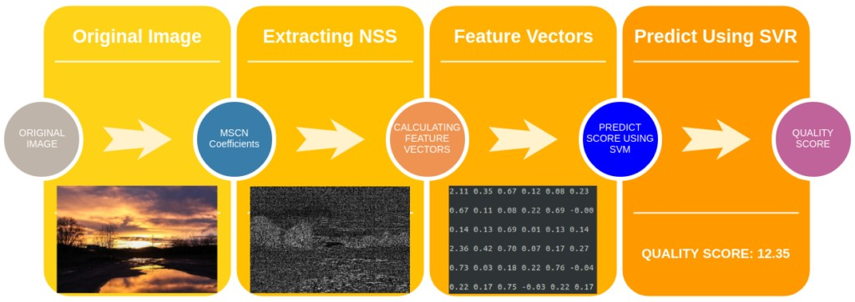
The steps involved in calculating BRISQUE

Slide 6
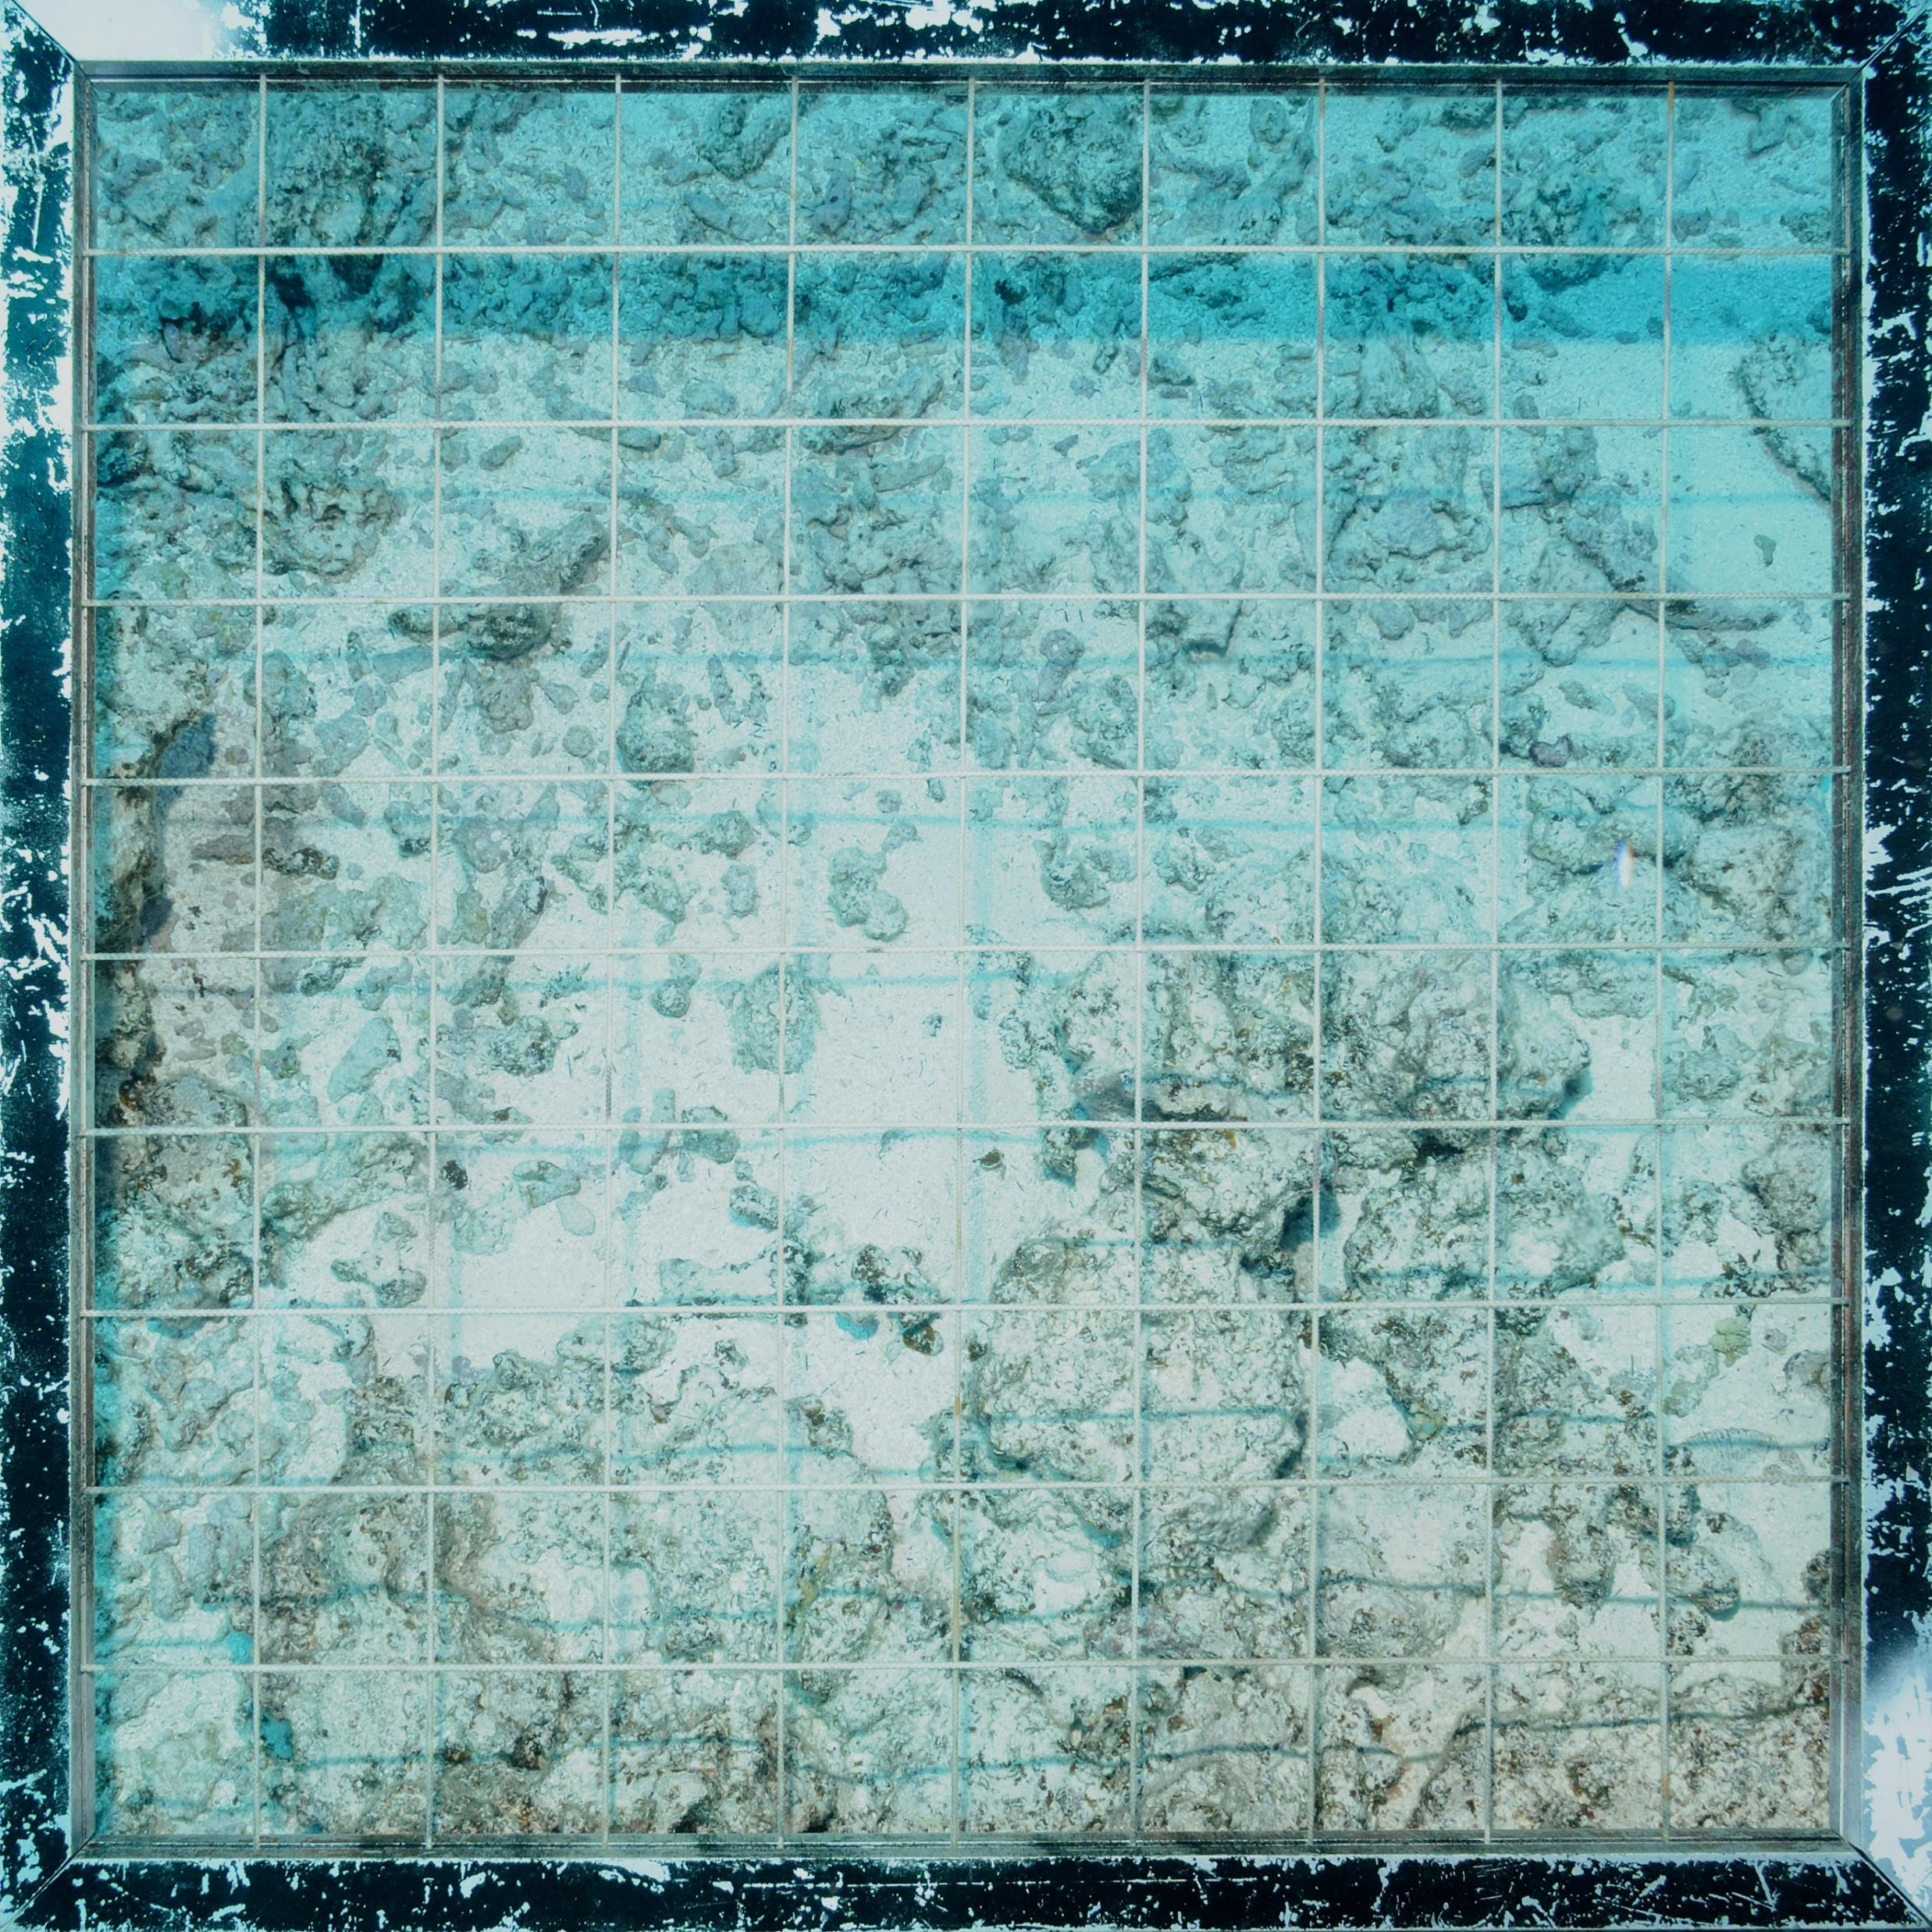
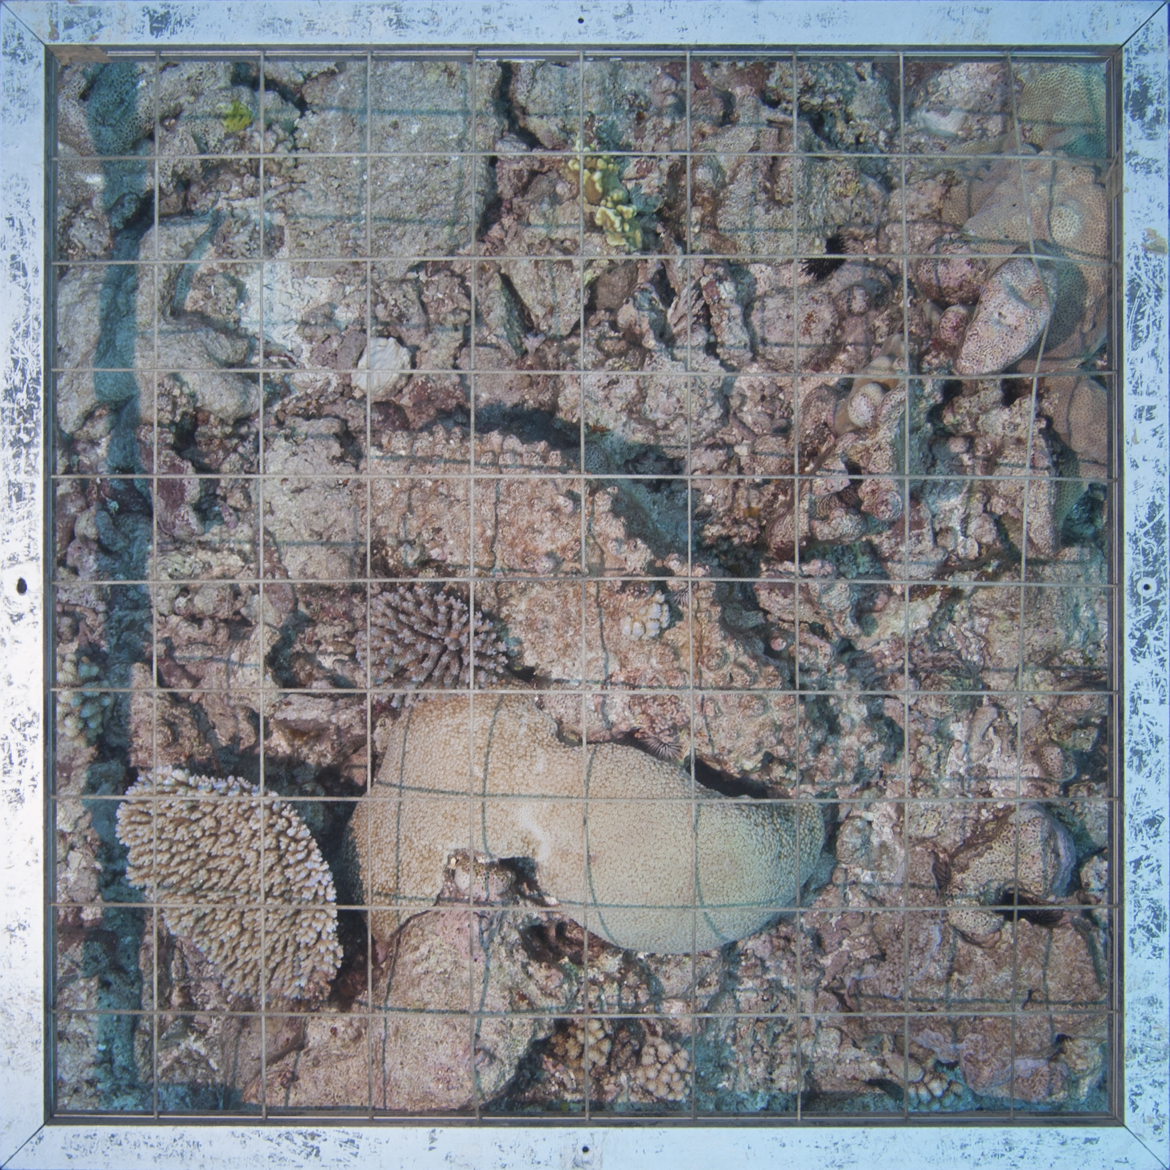
Resultats
IQA = 30.16
IQA = 21.50

